Slide 1
Auth0 Java Spring Boot Microservices
Student: Ulykpan Adilzhan Class: IT2-2210

Slide 2
Project Overview
Briefly describe the microservices project implemented based on the Auth0 tutorial.
Mention the core technologies involved (Spring Boot, Auth0 integration, microservice architecture).

Slide 3
Key Technologies
Spring Boot: For building the microservices.
Auth0: For OAuth2 authentication and JWT-based security.
Microservice Architecture: Breakdown of how microservices communicate and are structured in this project.
Add screenshots or a diagram if available to illustrate.

Slide 4
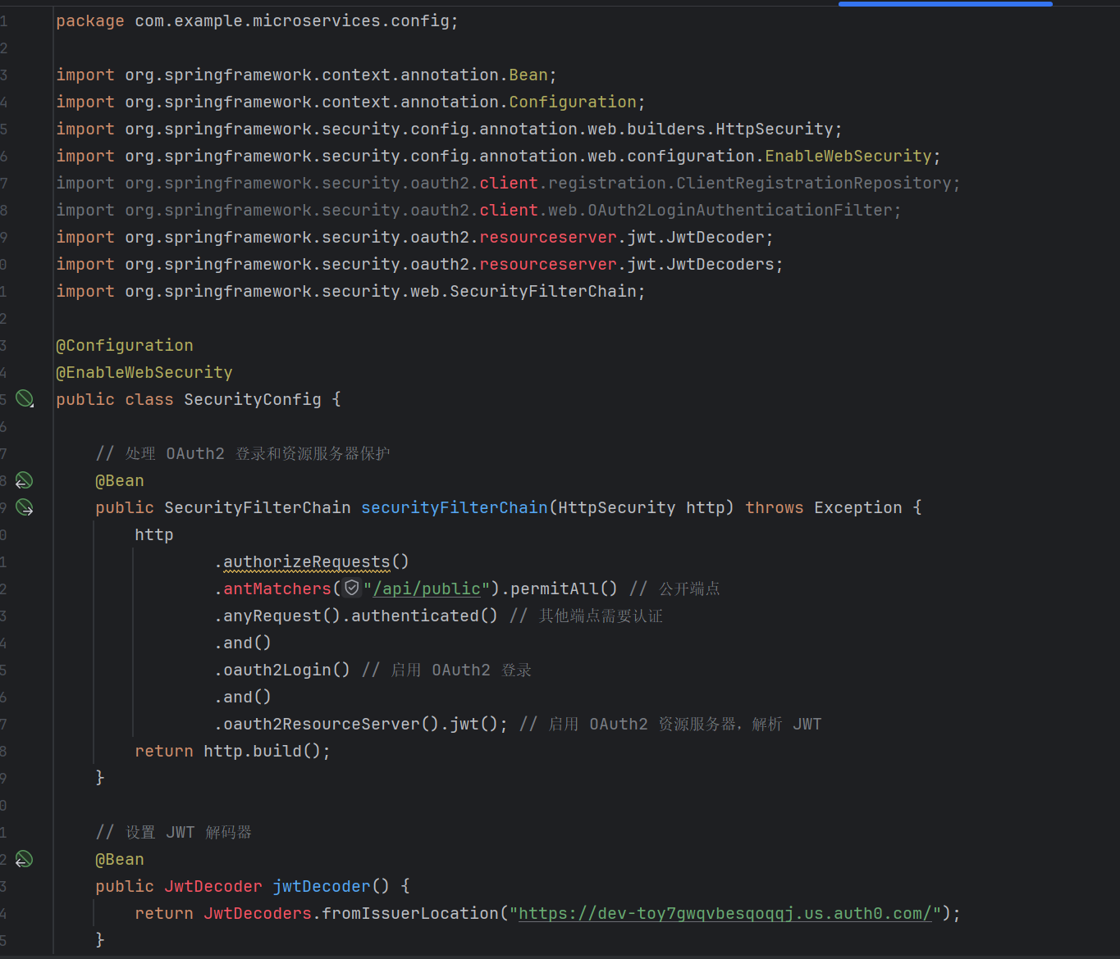
Key Concepts Implemented
OAuth2 Authentication: Authentication using Auth0 for securing APIs.
JWT Tokens: Used for securing requests between the microservices.
Service-to-Service Communication: Demonstrate how microservices communicate using RESTful APIs.

Slide 5
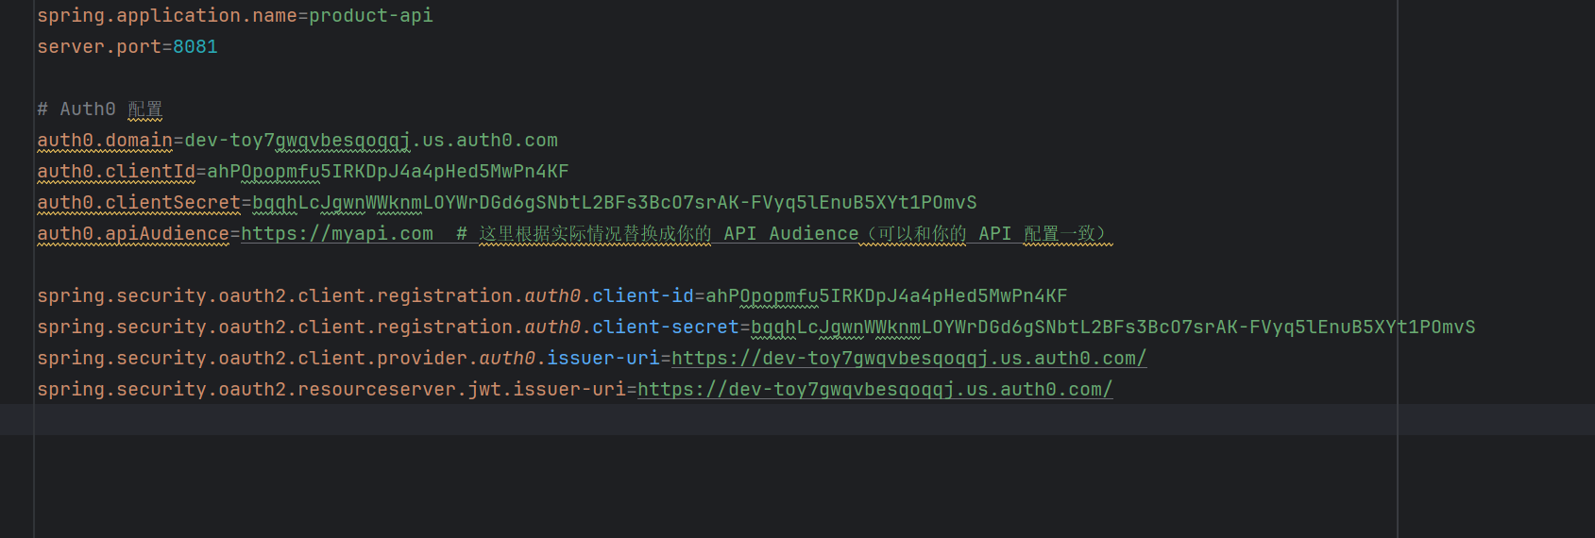
Step-by-Step Implementation
Show key steps you followed from the Auth0 tutorial:
Set up Spring Boot project.
Configured Auth0 with Spring Security.
Defined and tested microservice endpoints.
Include relevant screenshots showing code, configurations, and results.

Slide 6
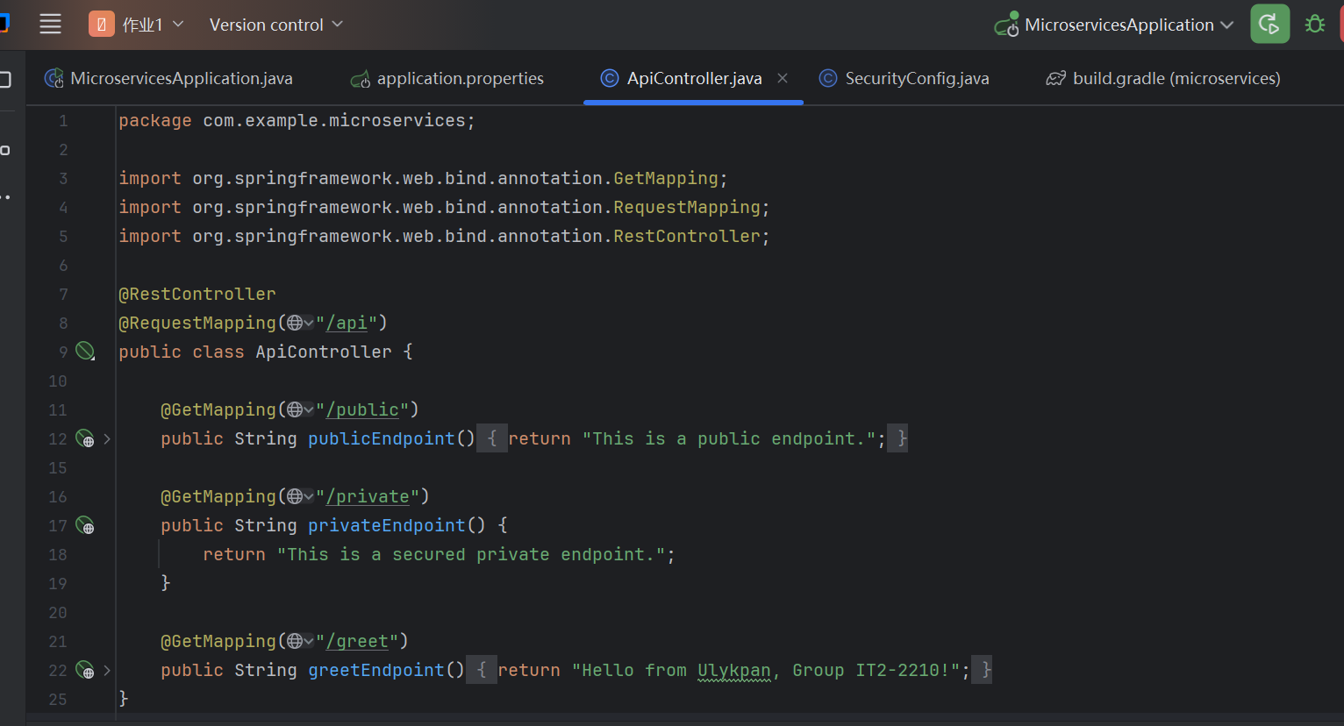
Implementing APIs
Implemented two main endpoints:
/api/public
/api/private

Slide 7
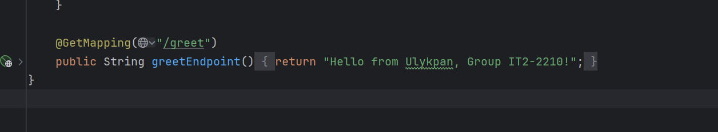
Unique Feature or Modification
Highlight a unique feature or modification you added:
Example: Additional security measures, custom endpoints, or extended functionality.
Explain how your addition builds upon the tutorial and adds value to the project.

Slide 8
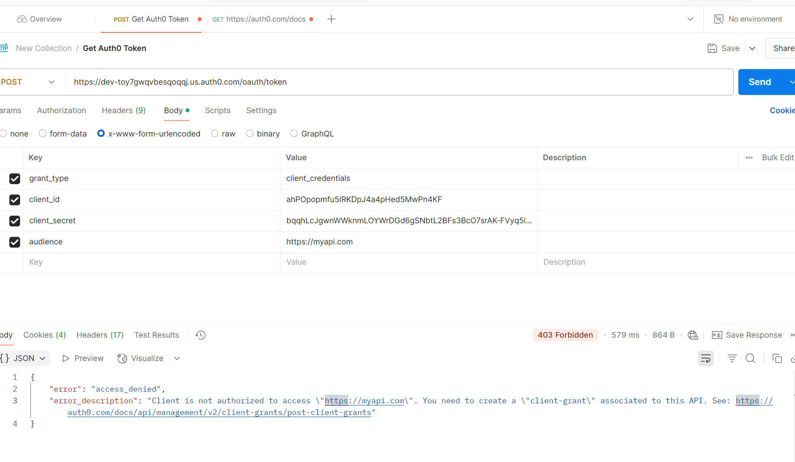
Demonstration of Working Microservices
Provide a demonstration of your working microservice(s).
You could show Postman screenshots where the endpoints are successfully tested.

Slide 9

Challenges and Solutions
Challenges**:
1. **OAuth2 Integration**: - The integration of OAuth2 authentication with Auth0 was initially challenging. Configuring the JWT decoding and ensuring proper validation of tokens between microservices was tricky.
2. **Service Communication**: - Setting up communication between microservices securely and managing API access permissions correctly took some time.
**Solutions**:
1. **OAuth2 Setup**: - Followed the tutorial step-by-step to configure OAuth2 login and resource server in Spring Boot, ensuring that JWT tokens were validated using the correct issuer and audience configurations.
2. **API Communication**: - Ensured that API Gateway was properly configured to route requests to appropriate microservices and that the microservices only accepted requests with valid tokens.

Slide 10

Key Learnings
1. **Spring Boot Microservices Architecture**: - Learned how to structure a Spring Boot application to use microservices effectively, ensuring scalabil

